Slide 1
Project Presentation: Finding a location to open a new Bangladeshi Restaurant in Toronto, Canada
Prepared for Capstone Project
Date: May, 25, 2021

Slide 2
Introduction:
Start a new highend Bangladeshi fusion restaurant in toronto area.
Select a location based on following
If the neighborhood has any Bangladeshi or Bengali lauguage spoken people
Presense of other Bangladeshi or indian (cuisine close to Bangladeshi) restaurants in the neighborhood
Interested People
want to try new food in a highend environment
investors and people who like different cultures and very interested to try different food and at the same time earn a good income

Slide 3
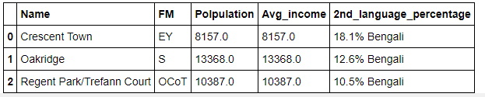
Data and Methodology:
Data Source:
https://en.wikipedia.org/wiki/Demographics_of_Toronto_neighbourhoods
Methodology
People of Bangladesh and some portion of Indian speaks in Bengali.
Location where Bengali is the 2nd language, will be the targeted locations.
Because they know the Bangladeshi culture and there will be demand for Bangladeshi food.
Find how many unique 2nd languages are there and if there is Bengali.
There are 26 different 2nd languages are in Toronto. Bengali is one of them.
Three target locations where 2nd language is Bengali

Slide 4
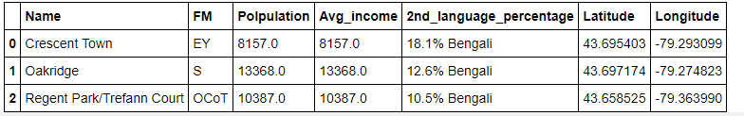
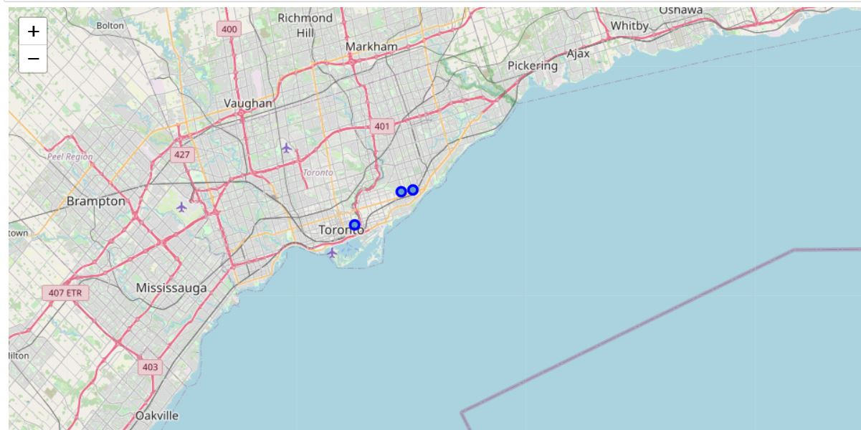
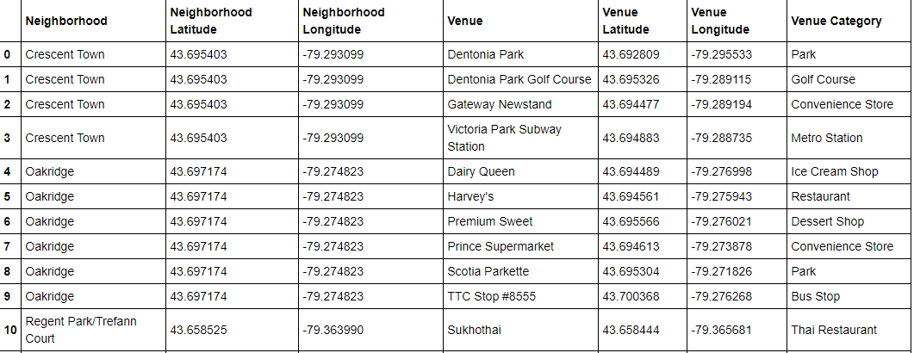
Data Analysis:
Geocode to get geographical coordinate of where 2nd language is Bengali:
Foursqaure app to used to know the existing restaurant in these target areas:
no Bangladeshi restaurant
find Indian Restaurant which is next close to Bangladeshi food.

Slide 5
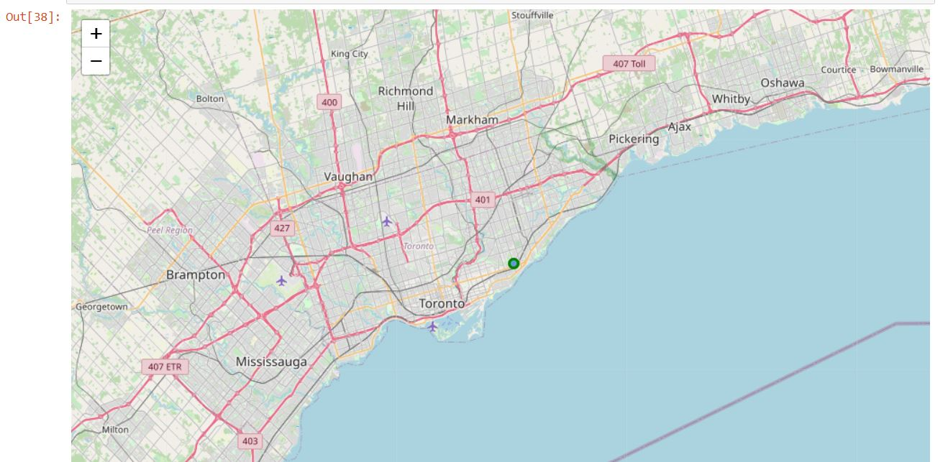
Conclusion:
Oakridge will be the great location for a new Bangladeshi restaurant
The Highest average income
The first one
Beautiful area near the beach

